Slide 1
Sorting Part 2
CS221 – 3/4/09

Slide 2
Announcements
Midterm: 3/11
  15% of your total grade
  We will review in class on 3/9
  You can bring one sheet of paper (both sides)
Guest Lectures
  Joe Walkuski on 3/27: Starting a technology business
  Joe Basirico on 4/17: Security Attacks and Vulnerabilities

Slide 3
Selection Sort
Find the smallest item in the list
Swap with the first unsorted item in the list
Repeat for remainder of the list

Slide 4
Selection Sort Visual
http://upload.wikimedia.org/wikipedia/en/b/b0/Selection_sort_animation.gif

Slide 5
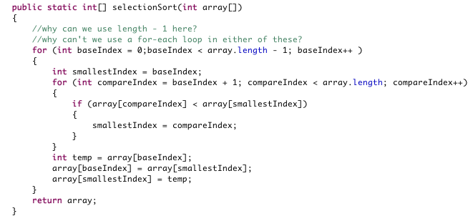
Selection Sort Questions
Can we use for-each loops?
  for (int baseItem : array)

Slide 6
For-Each Loop
Can’t use it
  Need access to the baseIndex from the outer loop
  Inner loop shouldn’t iterate through every item
  The underlying data will change
For-each is appropriate when:
  You only need read-access, not write
  You only need access to one element at a time
  You only need to move forward
  You want to iterate through every item

Slide 7
Selection Sort Questions
Should we use array.length – 1 or not?

Slide 8

Array.Length-1
In outer loop length - 1 is slightly faster
In inner loop you cannot use length - 1

Slide 9
Selection Sort Complexity
What is the time complexity?
  How many comparisons?
  How many exchanges?
What is the space complexity?
  Is the data exchanged in-place?
  Does the algorithm require auxiliary storage?

Slide 10
Selection Sort Complexity
Comparisons: O(n^2)
Exchanges: O(n)
Space: O(1)

Slide 11
Sort Matrix
Name | Worst Time Complexity | Average Time Complexity | Best Time Complexity | Worst Space (Auxiliary)
Selection Sort | O(n^2) | O(n^2) | O(n^2) | O(1)
Bubble Sort
Insertion Sort
Shell Sort
Merge Sort
Heap Sort
Quicksort

Slide 12
Bubble Sort
Simple to implement
Easy to understand
Bad (worst) performance

Slide 13
Bubble Sort Algorithm
For each item in the list
Compare to the item above
Swap if they are out of order
Repeat over the list until there are no more swaps

Slide 14
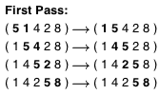

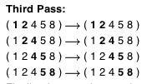
Example

Slide 15
Bubble Sort Visual
http://coderaptors.com/?BubbleSort

Slide 16
Pseudo Code
do
itemsSwapped = false
for index = 0 to array.length - 2
if (array[index] > array[index+1]
temp = array[index]
array[index] = array[index + 1]
array[index+1] = temp
itemsSwapped = true
while(itemsSwapped)

Slide 17
Bubble Sort Complexity
What is the time complexity?
  How many comparisons?
  How many exchanges?
What is the space complexity?
  Is the data exchanged in-place?
  Does the algorithm require auxiliary storage?

Slide 18
Bubble Sort Complexity
Comparisons: O(n^2)
Exchanges: O(n^2)
Space: O(1)

Slide 19
How to Optimize?
Notice that high values migrate to the top with each pass

Slide 20
Optimized Bubble Sort
passNumber = 0
do
itemsSwapped = false
for index = 0 to array.length - 2 - passNumber
if (array[index] > array[index+1]
temp = array[index]
array[index] = array[index + 1]
array[index+1] = temp
itemsSwapped = true
passNumber++
while(itemsSwapped)

Slide 21
Optimized Complexity
Does it change the big O value?
What is the impact?

Slide 22
Why is Bubble Sort so Slow?

Slide 23
Bubble Sort Performance
On average it requires many more exchanges than selection sort
Even though both are O(n^2), bubble sort is 40% slower!

Slide 24
Sort Matrix
Name | Worst Time Complexity | Average Time Complexity | Best Time Complexity | Worst Space (Auxiliary)
Selection Sort | O(n^2) | O(n^2) | O(n^2) | O(1)
Bubble Sort | O(n^2) | O(n^2) | O(n) | O(1)
Insertion Sort
Shell Sort
Merge Sort
Heap Sort
Quicksort

Slide 25
Insertion Sort
Still slow for large amounts of data, but…
Better performance than bubble or selection sort
Efficient for small data sets
Simple to implement and understand

Slide 26
Insertion Sort Algorithm
Assume a sorted and unsorted portion of the array
Unsorted portion starts as the first item only
For each item in the unsorted portion of the list
Insert the item into its proper place in the sorted portion of the list
Grow the sorted portion by one item and repeat
In other words:
For each item in the array starting with the second item
Shift each preceding item one slot up in the array
Until the correct location is found for the original item

Slide 27
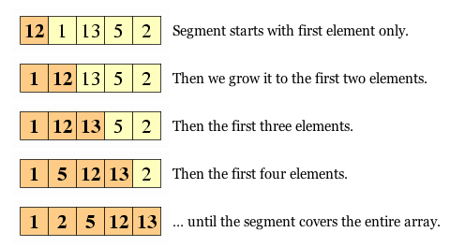
Insertion Sort Algorithm

Slide 28
Insertion Sort Visual
http://coderaptors.com/?InsertionSort

Slide 29
Pseudo Code
For index = 1 to array.length – 1
insert(array, index)

Slide 30
Insert
insertValue = array[index]
While index > 0 and insertValue < array[index-1]
array[index] = array[index-1]
index--
Array[index] = insertValue

Slide 31
Insertion Sort Complexity
What is the time complexity?
  How many comparisons?
  How many exchanges?
What is the space complexity?
  Is the data exchanged in-place?
  Does the algorithm require auxiliary storage?

Slide 32
Insertion Sort Complexity
Comparisons: O(n^2)
Exchanges: O(n^2)
Space: O(1)

Slide 33
Why is Insertion Sort Fast in Practice?
Up to 2 times faster than bubble sort
Almost 40% faster than selection sort
Yet it still has O(n^2) comparisons and exchanges…

Slide 34
Insertion Sort Performance
Insertion sort only looks at part of the list in each loop
Total comparisons are half of selection sort
Insertion does require more exchanges but…
  Each exchange moves one item instead of three
  Since there is no temp storage for most exchanges the writes are all within the array
  This means only references are changed
Limited need for temporary storage is a real benefit

Slide 35
Insertion Sort Performance
For small data-sets ~10 items, insertion sort is the fastest
Java uses insertion sort for small arrays and collections
Insertion sort can be used in combination with more complicated sorts as an optimization

Slide 36
Sort Matrix
Name | Worst Time Complexity | Average Time Complexity | Best Time Complexity | Worst Space (Auxiliary)
Selection Sort | O(n^2) | O(n^2) | O(n^2) | O(1)
Bubble Sort | O(n^2) | O(n^2) | O(n) | O(1)
Insertion Sort | O(n^2) | O(n^2) | O(n) | O(1)
Shell Sort
Merge Sort
Heap Sort
Quicksort

